Slide 1
Factors that cause traffic accidents in DC
Yuka & Connie

Slide 2
Data Collection
DC Govt : Traffic Data from 2000 - 2021
Pulled the data using the API
We split the data 2000 - 2010/2010-2021
Number of variables and observations

Slide 3
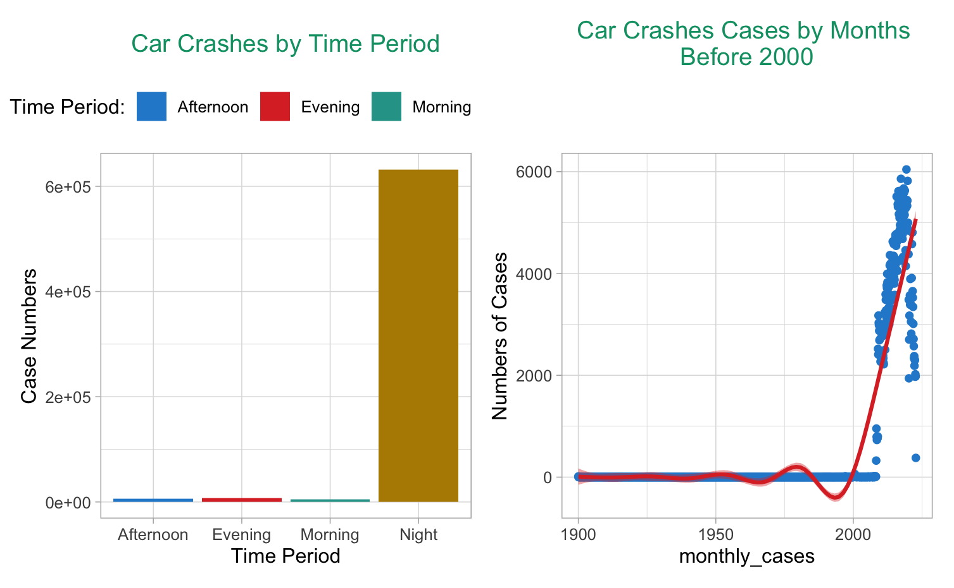
Data Exploratory Analysis

Slide 4
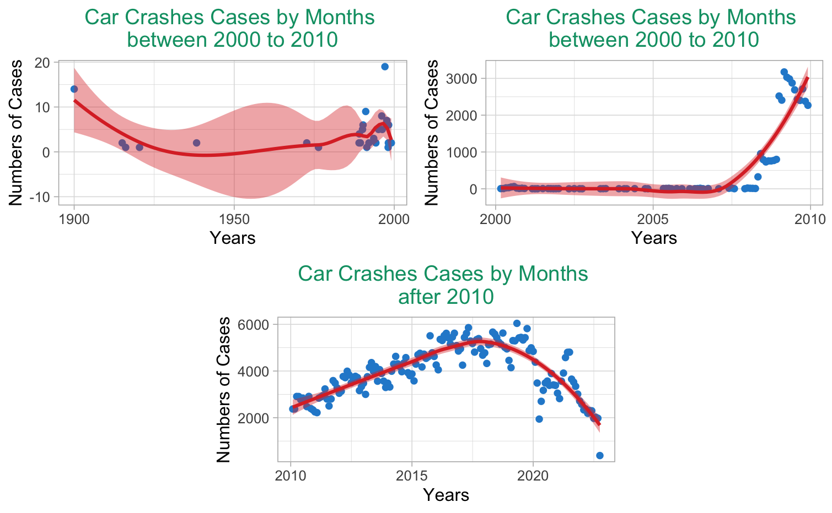
Data Exploratory Analysis

Slide 5
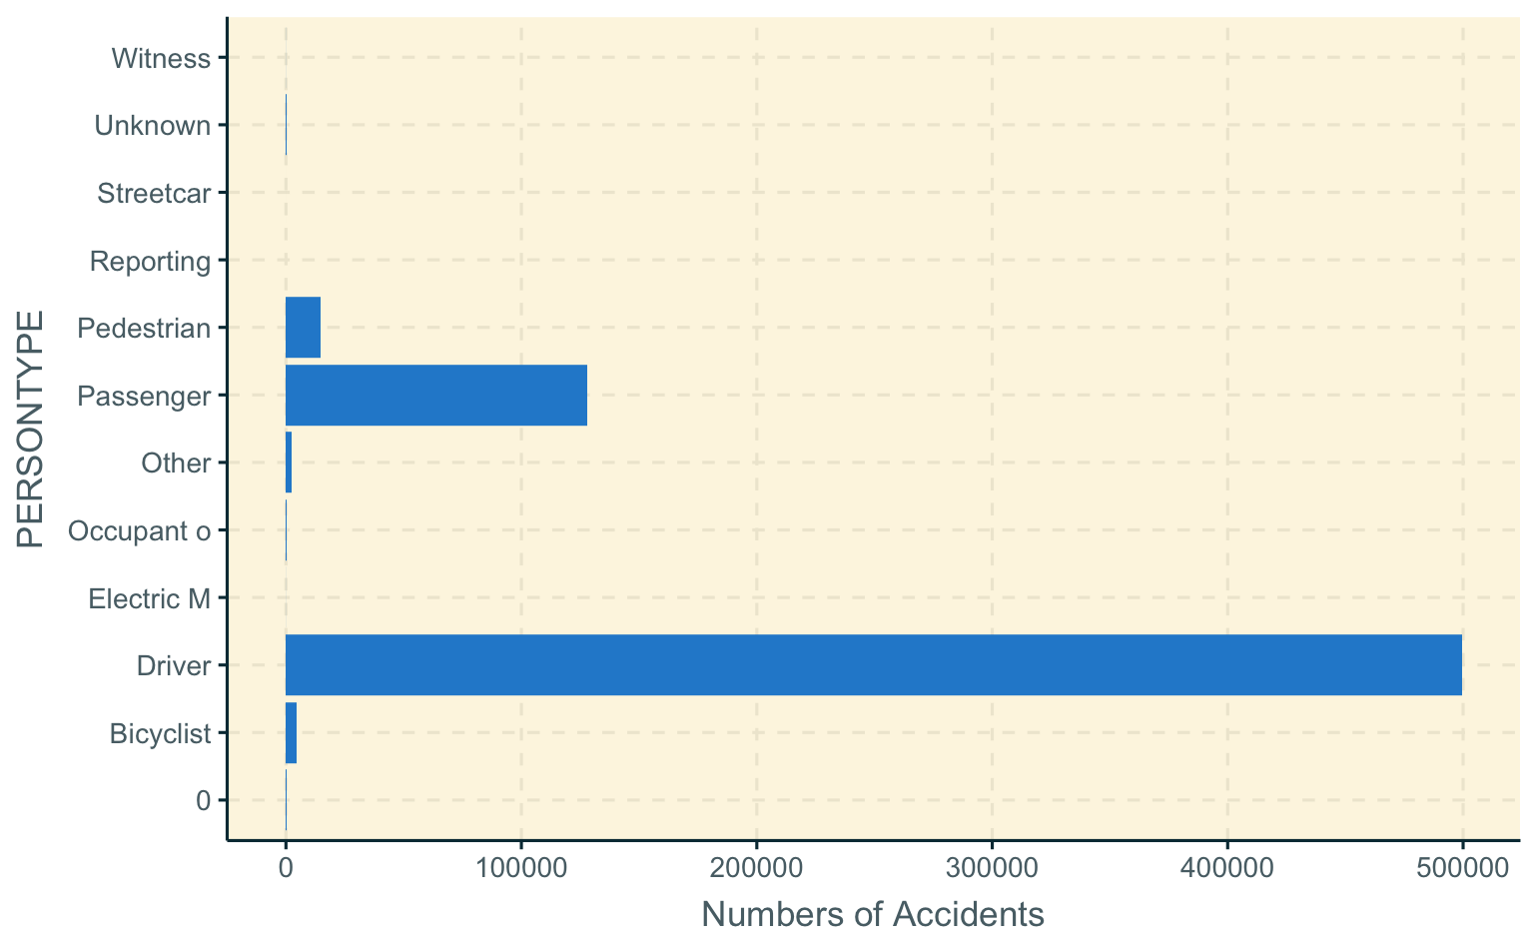
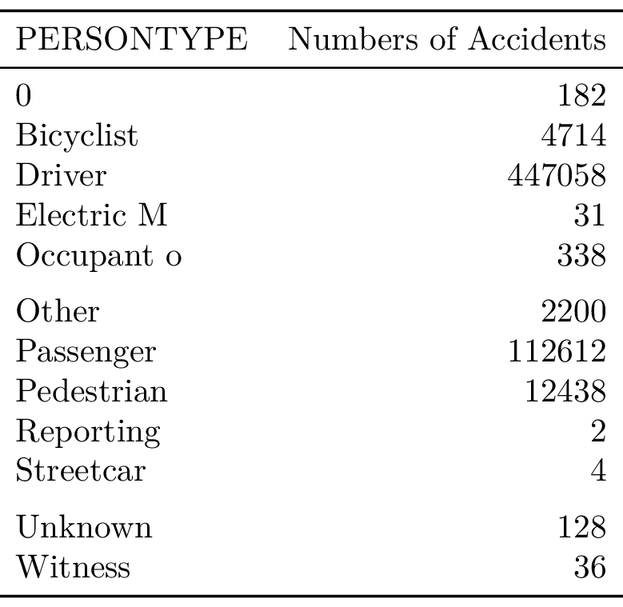
Data Exploratory Analysis

Slide 6
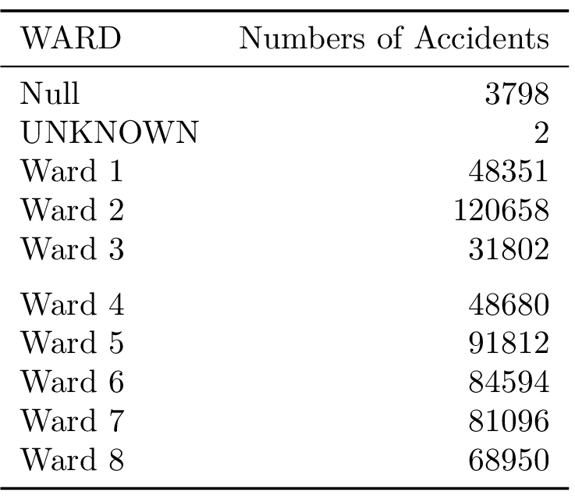
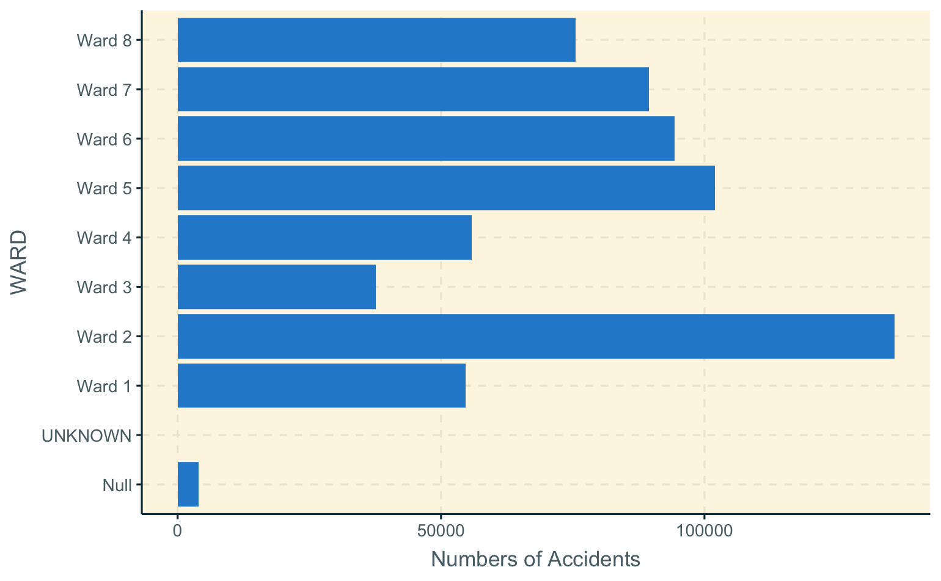
Data Exploratory Analysis

Slide 7

Project So Far
Milestones
Initial Data Set
Models and Initial Analysis
Great Communication among Group
Limitations
Time Management
Data Integration and Cleaning

Slide 8
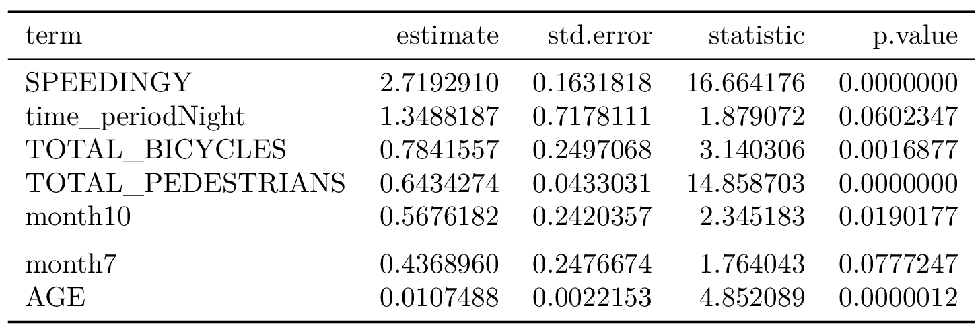
General Data Analysis
Logistic Regression
According to the 2020 census data Ward 7 and 8 have the lowest income levels and very high poverty level in the District of Columbia. However, our model do not show ward has as much influences compared to other predictors.
Pedestrians and bikers are at high risk of being involved in fatal accidents - there is a need for DC to invest in sidewalks and bicycle lanes.
Age also has strong effect on cause of fatal accidents.
Speeding is the strongest predictor for probabilities of be involved in Fatal accidents, for every accident that take place there is a probability of 2.71 if speeding.
Night Driving isn't safe in DC with probabilities of 1.34 of being involved in a fatal accident.

Slide 9

General Data Analysis
Decision Trees

Slide 10

General Data Analysis
KNN

Slide 11
References
Barba, Carolina Tripp, Miguel Angel Mateos, Pablo Reganas Soto, Ahmad Mohamad Mezher, and Mónica Aguilar Igartua. 2012. “Smart City for VANETs Using Warning Messages, Traffic Statistics and Intelligent Traffic Lights.” In 2012 IEEE Intelligent Vehicles Symposium, 902–7. IEEE.
Hayakawa, Hiroshi, Paul S. Fischbeck, and Baruch Fischhoff. 2000. “Traffic Accident Statistics and Risk Perceptions in Japan and the United States.” Accident Analysis & Prevention 32 (6): 827–35.
Keep, Matthew, and Tom Rutherford. 2013. “Reported Road Accident Statistics.” Commons Library Standard Note, SN/SG/2198.
Kingham, Simon, Clive E Sabel, and Phil Bartie. 2011. “The Impact of the ‘School Run’on Road Traffic Accidents: A Spatio-Temporal Analysis.” Journal of Transport Geography 19 (4): 705–11.
Marzoug, R, N Lakouari, O Oubram, H Ez-Zahraouy, A Khallouk, M Limón-Mendoza, and JG Vera-Dimas. 2018. “Impact of Traffic Lights on Car Accidents at Intersections.” International Journal of Modern Physics C 29 (12): 1850121.
Renouf, MA. 1991. “A Car Accident Injury Database: Overview and Analyses of Entrapment and Ejection.”

Slide 12

Our Repo:
https://github.com/yjchen9596/AU-GOVT670-F22-Projct

